Slide 1
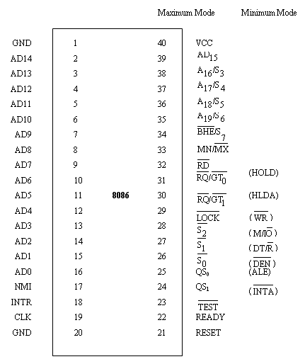
8086 Pin diagram
8086 is a 40 pin DIP using MOS technology. It has 2 GND’s as circuit complexity demands a large amount of current flowing through the circuits, and multiple grounds help in dissipating the accumulated heat etc. 8086 works on two modes of operation namely, Maximum Mode and Minimum Mode.

Slide 2
Power Connections
GND
1
40
VCC
Pin Description:
GND – Pin no. 1, 20
Ground
CLK – Pin no. 19 – Type I
Clock: provides the basic timing for the processor and bus controller. It is asymmetric with a 33% duty cycle to provide optimized internal timing.
VCC – Pin no. 40
VCC: +5V power supply pin
8086
CLK
19
GND
20

Slide 3
Address/ Data Lines
AD14
2
AD13
39
AD15
3
AD12
4
AD11
5
AD10
6
AD9
7
AD8
8
8086
AD7
9
AD6
10
AD5
11
AD4
12
AD3
13
AD2
14
AD1
15
AD0
16
Continued…

Slide 4
Pin Description
AD₁₅-AD₀ – Pin no. 2-16, 39 – Type I/O
Address Data bus: These lines constitute the time multiplexed memory/ IO address (T₁) and data (T₂, T₃, T_{W}, T₄) bus.

Slide 5




Address Lines
A14
2
39
A15
A13
3
A12
4
38
A11
5
A10
6
A9
7
37
A8
8
8086
A7
9
36
A6
10
A5
11
35
A4
12
A3
13
A2
14
A1
15
A0
16
Continued…

Slide 6
A₁₉/S₆, A₁₈/S₅, A₁₇/S₄, A₁₆/S₃ – Pin no. 35-38 – Type O
Address / Status: During T₁ these are the four most significant address lines for memory operations. During I/O operations these lines are low. During memory and I/O operations, status information is available on these lines during T₂, T₃, T_{W} and T₄.
Continued…

Slide 7






Status Pins S₀-S₇
38
S₃
37
S₄
36
S₅
35
S₆
8086
34
S₇
28
27
26
Continued…

Slide 8



Status Details
 |  |  | Indication
0 | 0 | 0 | Interrupt Acknowledge
0 | 0 | 1 | Read I/O port
0 | 1 | 0 | Write I/O port
0 | 1 | 1 | Halt
1 | 0 | 0 | Code access
1 | 0 | 1 | Read memory
1 | 1 | 0 | Write memory
1 | 1 | 1 | Passive
Continued…

Slide 9
S₄ | S₃ | Indications
0 | 0 | Alternate data
0 | 1 | Stack
1 | 0 | Code or none
1 | 1 | Data
Continued…

Slide 10



----- Value of Interrupt Enable flag
----- Always low (logical) indicating 8086 is
on the bus. If it is tristated another bus
master has taken control of the system bus.
----- Used by 8087 numeric coprocessor to
determine whether the CPU is a 8086 or
8088

Slide 11
Interrupts
8086
Pin Description:
NMI – Pin no. 17 – Type I
Non – Maskable Interrupt: an edge triggered input which causes interrupt.
NMI
17
INTR
18
Continued…

Slide 12
INTR – Pin No. 18 – Type I
Interrupt Request: is a level triggered input

Slide 13






Min mode signals
33
VCC
31
HOLD
30
HLDA
29
28
8086
27
26
25
ALE
24
Continued…

Slide 14
Pin Description
HOLD, HLDA – Pin no. 31, 30 – Type I/O
HOLD: indicates that another master is requesting a local bus “hold”. To be acknowledged, HOLD must be active HIGH.
Continued…

Slide 15
WR* - Pin no. 29 – Type O
Write: indicates that the processor is performing a write memory or write I/O cycle, depending on the state of the M/IO* signal.
M/IO* - Pin no. 28 – type O
. It is used to distinguish a memory access from an I/O access.”.
Continued…

Slide 16
DT/R* - Pin no. 27 – Type O
Data Transmit / Receive: needed in minimum system that desires to use an 8286/8287 data bus transceiver. It is used to control the direction of data flow through the transceiver.
DEN* - Pin no. 26 – Type O
Data Enable: provided as an output enable for the 8286/8287 in a minimum system which uses the transceiver.
Continued…

Slide 17
ALE – Pin no. 25 – Type O
Address Latch Enable: provided by the processor to latch the address into the 8282/8283 address latch.
INTA* - Pin no. 24 – Type O
INTA* is used as a read strobe for interrupt acknowledge cycles.

Slide 18



Max mode signals
33
GND
31
30
29
8086
28
27
26
25
QS₀
24
QS₁
Continued…

Slide 19
Pin Description:
RQ*/GT0*, RQ*/GT1* - Pin no. 30, 31 – Type I/O
Request /Grant: pins are used by other local bus masters to force the processor to release the local bus at the end of the processor’s current bus cycle. Each pin is bidirectional with RQ*/GT0* having higher priority than RQ*/GT1*.
Continued…

Slide 20
LOCK* - Pin no. 29
LOCK* : output indicates that other system bus masters are not to gain control of the system bus while LOCK* is active LOW.
QS₁, QS₀ – Pin no. 24, 25
Queue Status:
Continued…

Slide 21
QS₁ | QS₀ | Characteristics
0(LOW) | 0 | No operation
0 | 1 | First Byte of Op Code from Queue
1 (HIGH) | 0 | Empty the Queue
1 | 1 | Subsequent byte from Queue

Slide 22
Pin Description:
RD* - Pin no. 34, Type O
Read: Read strobe indicates that the processor is performing a memory of I/O read cycle,
READY – Pin no. 22, Type I
READY: is the acknowledgement from the addressed memory or I/O device that it will complete the data transfer. The READY signal from memory / IO is synchronized by the 8284A Clock Generator to form READY.
Continued…

Slide 23
TEST* - Pin No 23 – Type I
TEST* : input is examined by the “Wait” instruction. If the TEST* input is LOW execution continues, otherwise the processor waits in an “idle” state.
RESET – Pin no. 21 – Type I
Reset: causes the processor to immediately terminate its present activity.
Continued…

Slide 24
BHE*/S7- Pin No. 34 – Type O
Bus High Enable / Status:
BHE* | A₀ | Characteristics
0 | 0 | Whole word
0 | 1 | Upper byte from / to odd address
1 | 0 | Lower byte from / to even address
1 | 1 | None
Continued…

Slide 25
MN/MX* - Pin no. 33 – Type - I
Minimum / Maximum: indicates what mode the processor is to operate in.

Slide 26
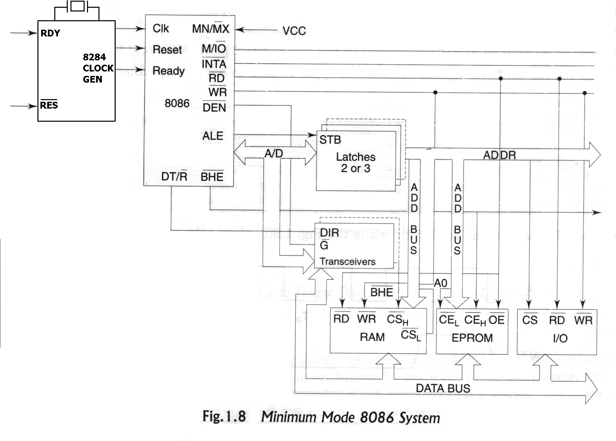
Minimum Mode 8086 System
MRD
DMUX
MWR
IORD
IOWR

Slide 27
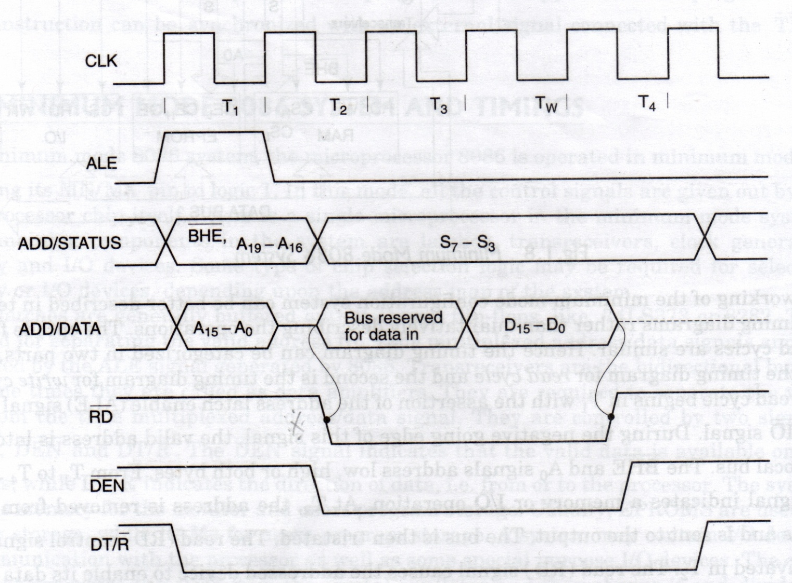
Read Cycle timing Diagram for Minimum Mode

Slide 28
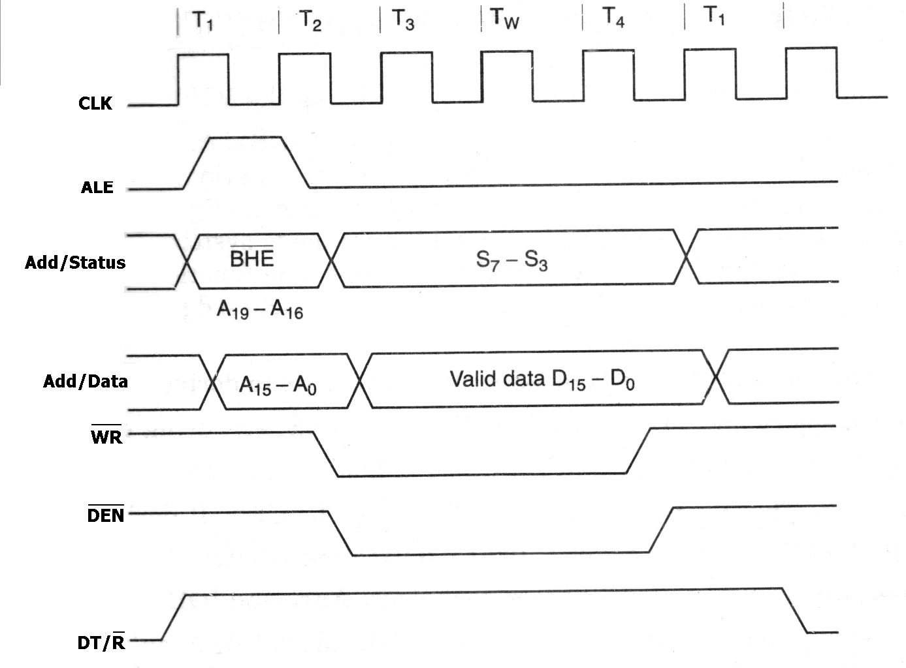
Write Cycle timing Diagram for Minimum Operation

